Slide 1

Data Analytics in Telecommunication Industry
By Analyzing user Behavior preferences, and patterns, telecom companies can tailor their services to meet the specific needs of their customers. This data-driven approach allows for the optimization of network performance, personalized service offerings, and proactive issue resolution, ultimately leading to heightened customer satisfaction.
User analytics provides valuable insights into network usage patterns and trends. Telecom companies can leverage this information to optimize their network infrastructure, ensuring efficient resource allocation, reducing congestion, and enhancing overall network performance
Leveraging user analytics enables informed decision-making, helping telecom providers stay competitive, anticipate trends, and drive innovation.

Slide 2
Non-graphical Univariate analysis
Dispersion Parameter
Range (Dispersion_Parameter):
Computes the range, indicating the overall spread by measuring the difference between the maximum and minimum values in the dataset.
Interquartile Range (IQR):
Calculates the IQR, a robust measure of dispersion, by determining the range of the central 50% of the dataset between the first (q1) and third (q3) quartiles.
Quartiles (q1 and q3):
Computes the first (q1) and third (q3) quartiles, crucial in understanding the distribution of the data and essential components in calculating the IQR.

Slide 3
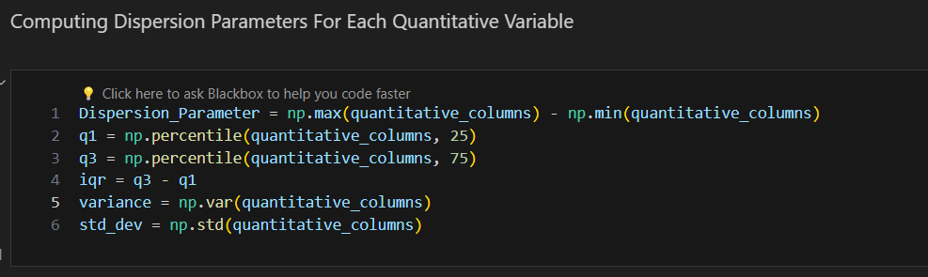
Variance:
Determines the variance, providing insight into the average squared deviation of individual data points from the mean and indicating the overall variability in the dataset.
Standard Deviation:
Calculates the standard deviation, the square root of the variance, offering a more interpretable measure of how individual data points deviate from the mean.
# That’s a Original Code For Your Prefrence :

Slide 4
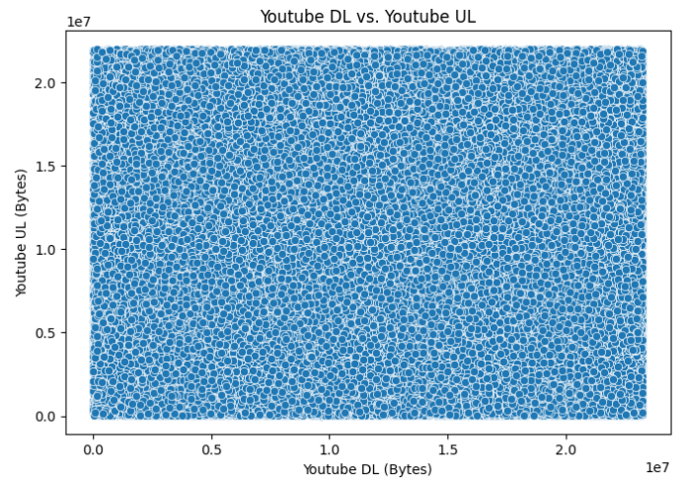
Graphical Univariate Analysis
Explore the relationship between each application and total download/upload data using scatter plots or correlation matrices. Interpret findings to comprehend the impact of different applications on data usage.
Scatter plot Showing total Youtube (Download’s Vs Upload’s)
"The plot of YouTube total download vs. upload showcases a significant asymmetry, emphasizing the platform's inherent nature where content consumption notably outweighs content creation."

Slide 5
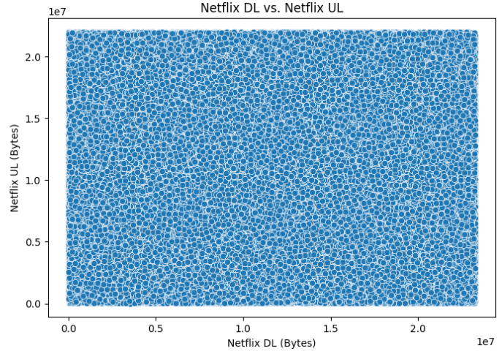
2. Scatter plot Showing total Netflix (Download’s Vs Upload’s)
"In the Netflix download vs. upload plot, it's clear that more focus is on delivering content to users rather than user-generated uploads, reflecting the platform's primary purpose of providing a seamless viewing experience."

Slide 6
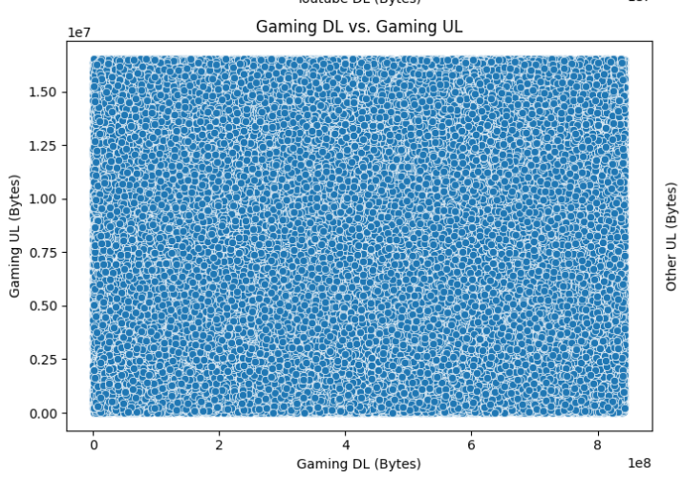
3. Scatter plot Showing total Gaming (Download’s Vs Upload’s)
“The gaming download vs. upload plot shows a balanced interplay, emphasizing the interactive essence of gaming where both downloading and uploading contribute significantly to the overall gaming experience.”

Slide 7
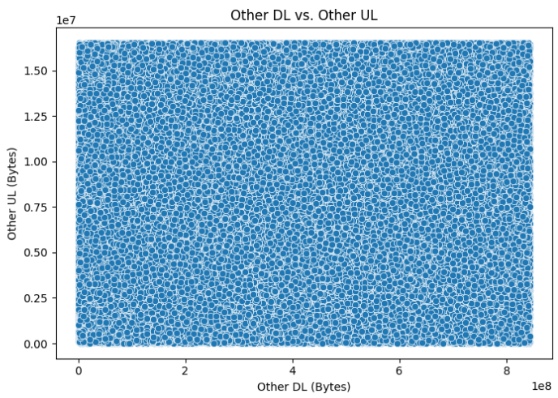
4. Scatter plot Showing total Other (Download’s Vs Upload’s)
"The plot for 'Other' activities' total download vs. upload presents a diverse landscape, showcasing a variety of user interactions and indicating a rich tapestry of both downloading and uploading activities across different content types or platforms."

Slide 8
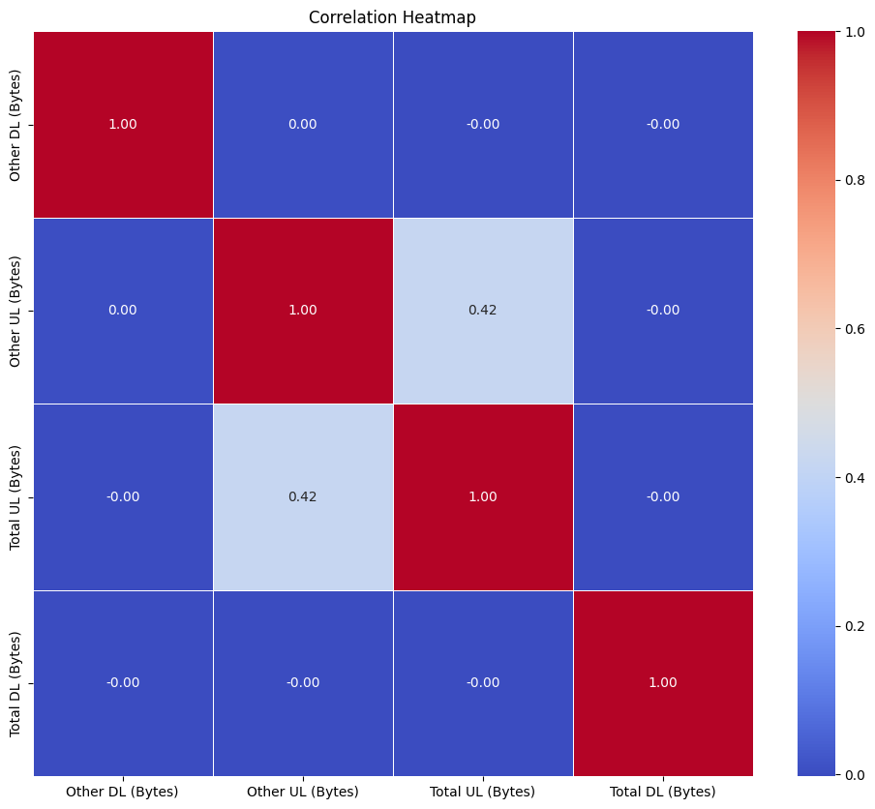
Correlation Matrix
“This Correlation Matrix show the total Download’s and Upload’s of the Entire Application Present In Dataset’s “

Slide 9
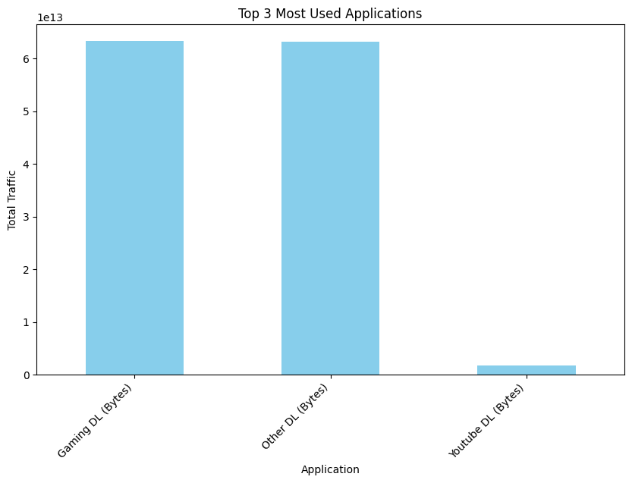
TASK -2 (User Engagement Analysis) Top 3 Most Used Application
This graph show the top 3 most used application by User which was Gaming Application’s & Youtube And Other Application’s

Slide 10
CONCLUSION:
The telecommunication dataset analysis has provided valuable insights into customer behavior, network dynamics, and overall business performance. The combination of non-graphical and graphical analyses, along with dispersion metrics, contributes to a comprehensive understanding of the dataset, laying the foundation for strategic planning and decision-making in the telecommunications industry.

